Slide 1
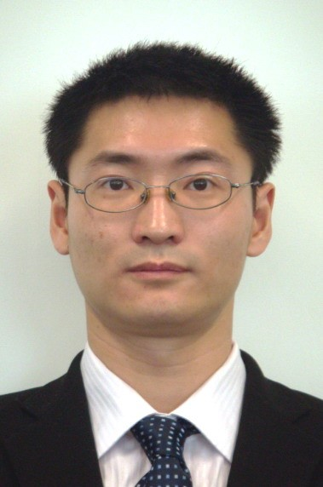
Career Experience
Relevant Projects (Excerpt)
JIN YAO
Data Engineer
Bank of China software center
Project manager 2 years
forex exchange management system
Chang Xing Group
software engineer 8 years
financial and big data project development
・ forex exchange management system
Description：some design of the system and take charge of its progress and quality assurance.
Skill：j2ee, oracle
・ Healthy Scale of State Physical Culture Administration
Description ：build the hadoop , kafka and spark clusters , cleaning the collected data and then use xgboost to analyze it.
Skill：kafka,spark,python
・ strategy development with some securities trader
Description ：collect the more than 3000 stocks’ daily data of the Shanghai and Shenzhen Stock Exchange , use kinds of ML algorithm to analyze them and provide a valid strategy.
Skill：tensorflow,deep learning,xgboost,SVM,random forest
Profile
10 years technical and 2 years management experience, rich experience in development of financial system.Good at j2ee development of Japanese project.Familiar with big data such as Hadoop,kafka and spark.
Experience with python and tensorflow in data analysis of financial data and NLP.
Expertise
PHP 2 years
Java 8 years
Python 2 years
Spark 2 years
tensorflow 1 year
DB2 1 year
MySQL 1 year
Oracle 2 years
CentOS 6/7 2 years
Japanese： level 1 (reading& writing)
English ： level 6 (reading& writing)

